Slide 1
iGo Travel Everyday
SOEN 6481
SOFTWARE SYSTEMS REQUIREMENTS SPECIFICATION: SECTIONSS FALL 2019
By Sriparna Chakraborty
40069488

Slide 2
Introduction
iGo is an electronic payment system that makes travelling on transit faster and easier
It works across local transit services in Canada, making paying for your trip simple, convenient and secure
It allows customers to travel seamlessly across multiple transit agencies with the one electronic fare card by tapping their card at stations and on buses.
With iGO, it is assumed that metro stations and buses have smart phones/tablets on which the application will be installed, to scan and validate the electronic tickets. With the official iGo app you can manage your card anytime, anywhere.

Slide 3
Stakeholders
The following are the stakeholders of iGo software, classified based on
their influence and importance:
1. Users: High influence, High importance.
2. Government: High influence, High importance
3.Banks: Low influence, Moderate importance
4 Software Engineers: High influence, Low importance
5.Negative Stakeholders: Low influence, Low importance

Slide 4
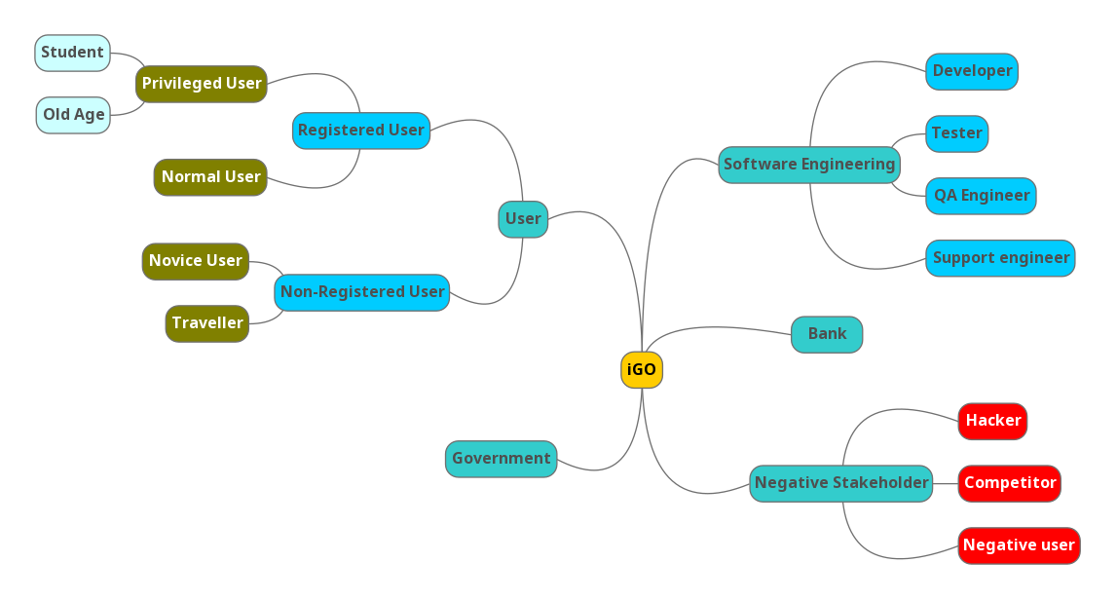
Mind Map Stakeholders

Slide 5
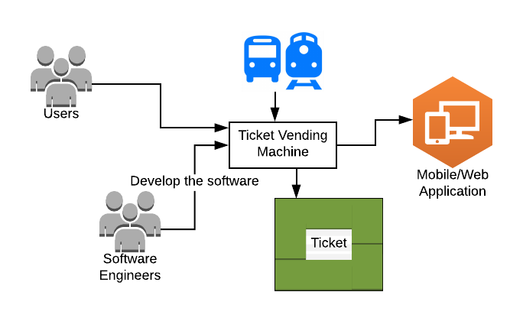
Context Of Use Diagram

Slide 6
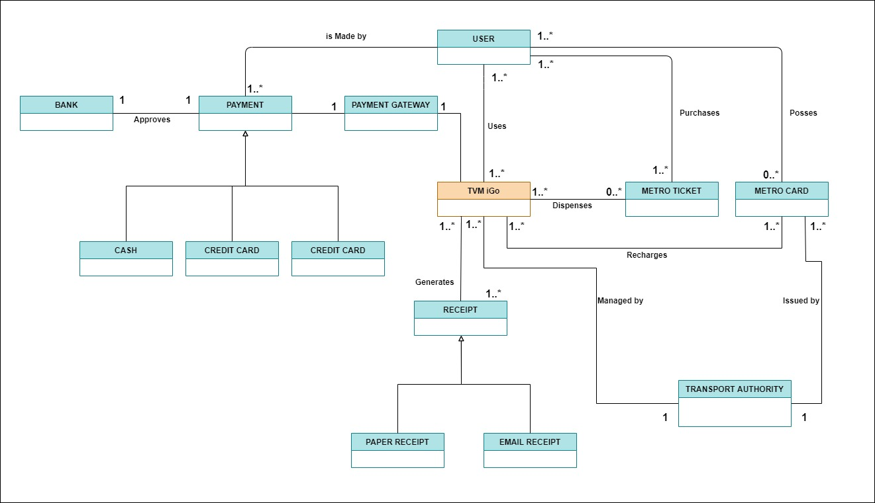
Domain Model

Slide 7
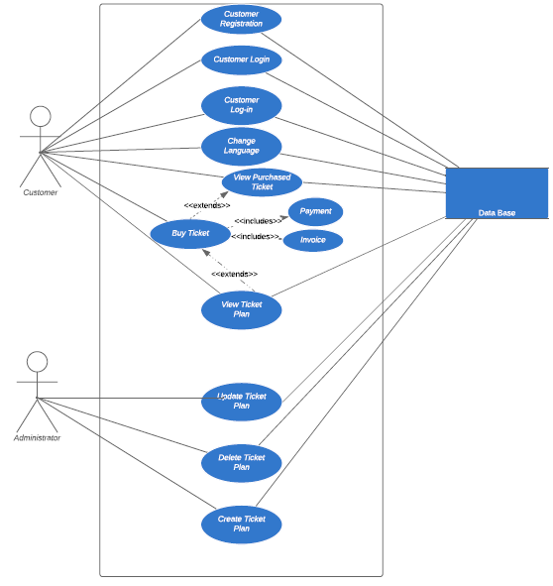
Use Case Model

Slide 8
Interview Analysis for User Stories
Based on the analysis of the interview done, the conclusion drawn was the
derivation of the following user stories:
Registration
2. Users wants to buy ticket online.
3. Senior citizens and students want to buy tickets at concession plan.
4. Users want to recharge iGo card monthly.
5. Effective use of resources.
6. Produce clean and effiecient code that is based on specifications.

Slide 9
User Stories
Id | User Story Description | User Roles | User Goal | Reason | Priority
US1 | New user wants to register in the system | Unregistered User | Register to the system | To buy ticket to access the transport facility | 4
US2 | A registered user wants to log into the system | Registered User | Login to the system | To buy ticket to access the transport facility | 4
US3 | User wants to buy ticket at concession | Registered User(Senior citizen / Student) | Buy Ticket at a lower price | To get a ticket at a discounted price | 3
US4 | Government can view the logs of ticket | Government | Document/Log the ticket purchases/use | Analyze the ticket purchases and uses | 3
US5 | User wants to a buy a monthly/yearly ticket pass for travel | User | Buy monthly/yearly pass | To access the pass facility | 5
US6 | User wants to make changes to existing ticket plan | User | Make change in existing ticket plan | To modify ticket plan | 2
US7 | User wants to recharge card online | User | Recharge ticket online | To get online recharge facility | 4
US8 | User wants to get e-receipt upon purchasing a ticket | User | Get e-receipt | To get a receipt online | 4
US9 | A user want to select the different plan options | Registered User | Select the available travel plans | To buy ticket plan to access the transport facility | 4
US10 | A user buy the ticket and get confirmation | Registered user | Enter the card details and buy the ticket plan | To buy ticket plan to access the transport facility | 5

Slide 10
Traceability Matrix
User story name |  | Interviews / Survey | Use cases | User story | Previous Project | Academic Research
Registration | US1 | X | X |  | X
Login | US2 |  | X |  | X
Buy ticket at a concession (Senior Citizen/Student) | US3 | X |  | X
View Ticket Log | US4 |  | X
Buy a pass(monthly/yearly) | US5 | X |  | X | X
Modify ticket plan | US6 | X |  | X
Recharge card online | US7 | X |  | X | X
Generate e-receipt | US8 | X | X |  |  | X
Ticket Plan | US9 | X | X
Buy Ticket | US10 |  | X

Slide 11
Collaboration Pattern
For this project, a number of student collaboration patterns were used. Some are:
1.We centralized product work management using Google Docs to ensure that all team members had access to the latest artifacts versions.
2. We Managed the project by assigning various tasks with deadlines to
all members of the group.
3. We Regularly checked to ensure our project was in line with the
project description.
4. We Started Working on the project immediately

Slide 12
Criticat Decision
Some of the major decisions for our project includes:
Scope: our project covered just creating Tickets that were functional for Metros and Buses only and the types of tickets were also limited.
2. Our interview and the number of interviews taken for user stories was also another critical decision as we wanted to ensure it properly covered the population.
3. Assigning use cases and stakeholders priority was another critical decision.
4. The types of users for our product.
5. The stakeholders in the project.

Slide 13
Reuse Potential
The iGO TVM developed can be extended to any mode of travel systems and it can be implemented in any city or province in Canada.

Slide 14
Lesson Learnt
1. Collaborating effectively in a team.
2. Respecting each other's views and coming to a conclusion.
3. Critical Decision Making.
4. Extracting the requirements for the project and documenting them.

Slide 15
References
[O'hEocha, Conboy, 2010] The Role of the User Story Agile Practice in Innovation. By C. O'hEocha, K. Conboy. The First International Conference on Lean Enterprise Software and Systems (LESS 2010).
Helsinki, Finland. October 17-20, 2010.
[Overgaard, Palmkvist, 2005] Use Cases: Patterns and Blueprints. By G. Overgaard, K. Palmkvist. Addison-Wesley. 2005.
[Cleland-Huang, Gotel, Zisman, 2012] Software and Systems Traceability. By J. ClelandHuang, O. Gotel, A. Zisman (Editors). Springer-Verlag.2012.
[Keeling, 2017] Design It! From Programmer to Software Architect. By M. Keeling. The Pragmatic Programmers. 2017.
[Alonso-Ríos, Mosqueira-Rey, Moret-Bonillo, 2018] A Systematic and Generalizable Approach to the Heuristic Evaluation of User Interfaces. By D. Alonso-Ríos, E. Mosqueira-Rey, V. Moret-Bonillo. International Journal of Human-Computer Interaction. Volume 34. Number 12. 2018. Pages 1169-1182.
https://www.tutorialspoint.com/articles/how-to-create-a-use-case-diagram

Slide 16


